Slide 1

BLOCKCHAIN TECHNOLOGY IN HEALTHCARE
Sripriya Dasoju

Slide 2
Introduction
Block chain, originally developed as the underlying technology for digital currencies, has developed into a decentralized and secure framework that holds guarantees for enhancing data integrity, interoperability, and transparency in healthcare.
The integration of blockchain technology into healthcare systems has the potential to revolutionize data management, enhance patient privacy, and streamline interoperability.
By creating an immutable and transparent record of health-related transactions, blockchain can facilitate trust among stakeholders, decrease fraud, and provide patients with greater control over their health data.

Slide 3
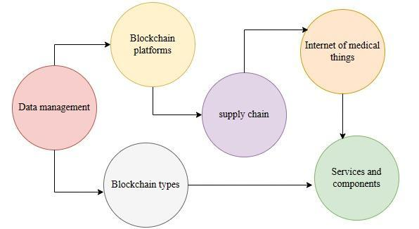
Thesis Objectives
The essential objective of this thesis is to investigate the potential components on blockchain applications in healthcare research. The framework of this research has been organized with a different collection of scholastic investigations and insightful works explicitly addressing the intersection of blockchain technology and healthcare. Another key objective is to examine the specified groups of research that concentrate on applied blockchain technology in healthcare settings (Agbo, Mahmoud, and Eklund 2019). This thesis has involved identifying and analyzing some particular datasets, initiatives, and investigations where blockchain has been integrated to manage precise difficulties or upgrade processes within the healthcare industry.
Figure 1: Key components of Blockchain
(Source: Self-Created)

Slide 4
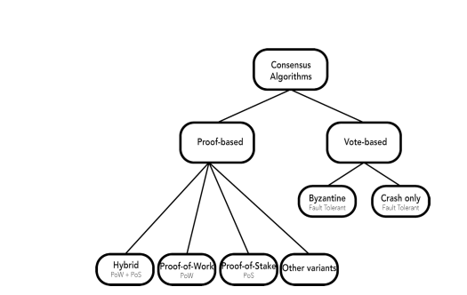
Literature Review
Enhances data integrity and security (Agbo, et al. 2019).
Focus on intelligent agreements and consensus algorithms (Chukwu & Garg, 2020).
IoT integration, treatment tracking, and medication management (AGUIAR et al. 2021).
Figure 2: Categorization of Blockchain Algorithms

Slide 5
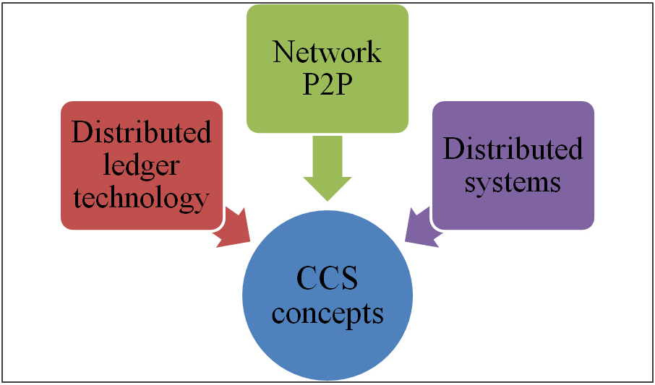
Blockchain in Healthcare Applications
Enhances data management and supply chain integrity (Farouk et al. 2021).
Streamlines health record management (Tanwar et al. 2020).
Utilizes IoT and blockchain for clinical data (Wang 2020).
Figure 3: Key components of CSS system

Slide 6
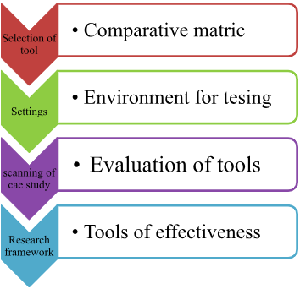
Research Framework
Blockchain adoption, data management, patient care.
Research Questions: How can blockchain improve healthcare data management?
Multi-layered research approach including literature review, observations, and case studies.
Figure 6: Research framework diagram

Slide 7
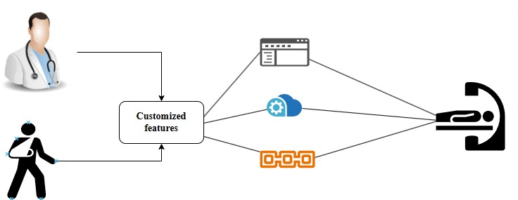
Data Requirements
Patient-driven Systems: Empowers patients with control over their health data.
Consent Management: Defines consent boundaries and granularity.
Smart Contracts: Automates and enforces healthcare processes.
Figure 8: Blockchain technology in healthcare settings

Slide 8
Data Requirement Table
Technology | Current growth rate | Projected revenue of industry | CAGR | Context
Blockchain Technology | 21% | $21.56 billion | 10% | Both quantitative and qualitative data are vital for blockchain technology in healthcare. Blockchain technology enhances data management and security in the healthcare sector.
Patient Identity Management | 35% | $93.65 billion | 16% | Patient Identity Management is a key growth factor for blockchain in healthcare. It involves securely capturing and storing patient information on the blockchain for identity verification.
Productive information manate | 24% | $106.23 billion | 21% | Ensuring interoperability is crucial for smooth data exchange among healthcare providers. Interoperability standards must balance patient privacy with effective information sharing.

Slide 9
Limitations
Challenges in securing and collecting healthcare data.
In case of Data Standardization, difficulty in achieving consistent data formats.
Issues in reaching consensus among multiple entities is consortium.

Slide 10
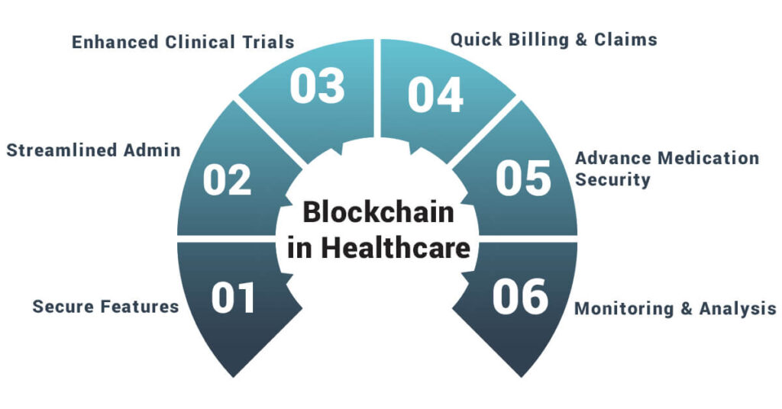
Future Research Agenda
Explore advanced data exchange methods.
For tracking, drugs, medical gear, and insurance claims using blockchain are monitored.
Improve interoperability among healthcare systems.

Slide 11

Conclusion
Blockchain is crucial for enhancing healthcare data management.
Trust: Builds trust among stakeholders through transparency.
Empowerment: Empowers patients with greater control over their health data.

Slide 12
Reference List
Agbo, C. C., Mahmoud, Q. H., &Eklund, J. M. (2019, April). Blockchain technology in healthcare: a systematic review. In Healthcare (Vol. 7, No. 2, p. 56). MDPI.Retrieved from: https://www.mdpi.com/2227-9032/7/2/56/pdf[Retrieved on: 26.11.2023]
Attaran, M. (2022). Blockchain technology in healthcare: Challenges and opportunities. International Journal of Healthcare Management, 15(1), 70-83. Retrieved from: https://www.researchgate.net/profile/Mohsen-Attaran/publication/345632338_Blockchain_technology_in_healthcare_Challenges_and_opportunities/links/5fa98a4d458515157bf74fd8/Blockchain-technology-in-healthcare-Challenges-and-opportunities.pdf [Retrieved on: 26.11.2023]
Chukwu, E., & Garg, L. (2020). A systematic review of blockchain in healthcare: frameworks, prototypes, and implementations. Ieee Access, 8, 21196-21214.Retrieved from: https://ieeexplore.ieee.org/iel7/6287639/6514899/08972918.pdf[Retrieved on: 26.11.2023]
De Aguiar, E. J., Faiçal, B. S., Krishnamachari, B., &Ueyama, J. (2020). A survey of blockchain-based strategies for healthcare. ACM Computing Surveys (CSUR), 53(2), 1-27.Retrieved from: https://repositorio.usp.br/directbitstream/19a33b4a-0b94-47da-9173-b985bf51ecb2/2993558++post-print.pdf[Retrieved on: 26.11.2023]
Farouk, A., Alahmadi, A., Ghose, S., &Mashatan, A. (2020). Blockchain platform for industrial healthcare: Vision and future opportunities. Computer Communications, 154, 223-235.Retrieved from: https://cointhinktank.com/upload/crypto/Blockchain%20Platform%20for%20Industrial%20Healthcare:%20Vision%20and%20Future.pdf[Retrieved on: 26.11.2023]
Ismail, L., Materwala, H., &Zeadally, S. (2019). Lightweight blockchain for healthcare. IEEE Access, 7, 149935-149951.Retrieved from: https://ieeexplore.ieee.org/iel7/6287639/8600701/08869754.pdf[Retrieved on: 26.11.2023]
Khan, F. A., Asif, M., Ahmad, A., Alharbi, M., &Aljuaid, H. (2020). Blockchain technology, improvement suggestions, security challenges on smart grid and its application in healthcare for sustainable development. Sustainable Cities and Society, 55, 102018.Retrieved from: https://faculty.pnu.edu.sa/haaljuaid/Documents/Sustainable.pdf[Retrieved on: 26.11.2023]
Khezr, S., Moniruzzaman, M., Yassine, A., &Benlamri, R. (2019). Blockchain technology in healthcare: A comprehensive review and directions for future research. Applied sciences, 9(9), 1736.Retrieved from: https://www.mdpi.com/2076-3417/9/9/1736/pdf [Retrieved on: 26.11.2023]
Krawiec, R. J., & White, M. (2023). Blockchain: Opportunities for health care. Deloitte.Retrieved from: https://thuvienso.hoasen.edu.vn/bitstream/handle/123456789/13538/14.%20Deloitte_2016_Blockchain%20Opportunities%20for%20Health%20Care.pdf?sequence=1[Retrieved on: 26.11.2023]
Rathee, G., Sharma, A., Saini, H., Kumar, R., & Iqbal, R. (2020). A hybrid framework for multimedia data processing in IoT-healthcare using blockchain technology. Multimedia Tools and Applications, 79(15-16), 9711-9733.Retrieved from: https://www.researchgate.net/profile/Geetanjali-Rathee/publication/333565209_A_hybrid_framework_for_multimedia_data_processing_in_IoT-healthcare_using_blockchain_technology/links/5d2d6a07a6fdcc2462e30cf3/A-hybrid-framework-for-multimedia-data-processing-in-IoT-healthcare-using-blockchain-technology.pdf[Retrieved on: 26.11.2023]
Siyal, A. A., Junejo, A. Z., Zawish, M., Ahmed, K., Khalil, A., &Soursou, G. (2019). Applications of blockchain technology in medicine and healthcare: Challenges and future perspectives. Cryptography, 3(1), 3.Retrieved from: https://www.mdpi.com/2410-387X/3/1/3/pdf[Retrieved on: 26.11.2023]
Syed, T. A., Alzahrani, A., Jan, S., Siddiqui, M. S., Nadeem, A., &Alghamdi, T. (2019). A comparative analysis of blockchain architecture and its applications: Problems and recommendations. IEEE access, 7, 176838-176869.Retrieved from: https://ieeexplore.ieee.org/iel7/6287639/8600701/08922632.pdf[Retrieved on: 26.11.2023]
Tanwar, S., Parekh, K., & Evans, R. (2020). Blockchain-based electronic healthcare record system for healthcare 4.0 applications. Journal of Information Security and Applications, 50, 102407.Retrieved from: https://e-tarjome.com/storage/panel/fileuploads/2019-12-23/1577094125_gh110.pdf[Retrieved on: 26.11.2023]
Tariq, N., Qamar, A., Asim, M., & Khan, F. A. (2020). Blockchain and smart healthcare security: a survey. Procedia Computer Science, 175, 615-620.Retrieved from: https://www.sciencedirect.com/science/article/pii/S1877050920317890/pdf?md5=fffa1621448d99f7691494b6612e8320&pid=1-s2.0-S1877050920317890-main.pdf[Retrieved on: 26.11.2023]
Wang, D. H. (2020). IoT based clinical sensor data management and transfer using blockchain technology. Journal of IoT in Social, Mobile, Analytics, and Cloud, 2(3), 154-159.Retrieved from: https://scholar.archive.org/work/icgwxbm7r5fmrhquyucc425b5y/access/wayback/https://www.irojournals.com/iroismac/V2/I3/03.pdf[Retrieved on: 26.11.2023]

Slide 13
Thank You!

